Slide 1
Stock Market Sector Analysis
S
William Granados
Bobby McGraw
Sina Rafiee

Slide 2
Scope
S
Analyze four different stock market sectors (Energy, Tech , Consumer, Health) over a 5 year interval.
Record any outliers in the data within individual sectors.
Highlight an aggregate comparison between the sectors, with the ability to explain the differences from sector to sector over time.

Slide 3
Questions we’ll be asking:
S
1. Which stock and sector held its value over the years?
2. Which field would we recommend to others, based on this data?
3. Which stock and sector had the greatest Increase? Decrease?
4. What patterns are identifiable across the stock market sectors?

Slide 4
Resources(Disclaimer)
W
Data displayed is from the NASDAQ API:https://data.nasdaq.com/api/v3/datasets/wiki/
Datasets are taken from 2005 to 2011
Six stocks per Stock Sector
Adjusted Open and Close Values were used in the datasets to account for splits and dividend share payouts
Notes:
Stocks were hand picked after testing datasets in the code

Slide 5
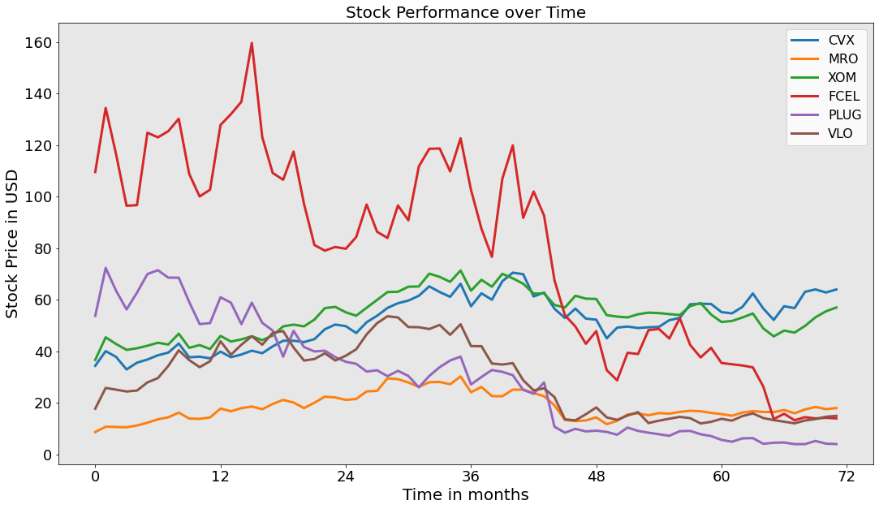
Energy Stock Comparison 2005 - 2011
W
CVX(Chevron)
MRO (Marathon Oil)
XOM(Exxon Mobil)
FCEL(FuelCell Energy)
PLUG(Plug Power)
VLO(Valero Energy)
Notes:
Which Stock held its value over the years?
Chevron & Exxon
Which Stock had the greatest increase? Decrease?
Increase: Chevron Decrease: FCEL

Slide 6
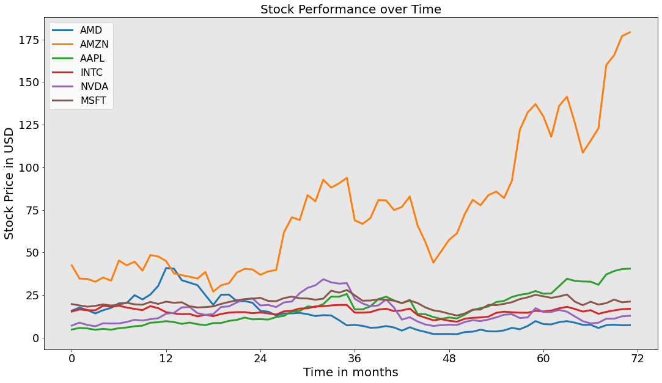
Tech Stock Comparison 2005 - 2011
W
AMD(Advanced Micro Devices)
AMZN(Amazon)
AAPL(Apple)
INMTC(Intel)
NVDA(NVIDIA)
MSFT(Microsoft)
Notes:
Which Stock held its value over the years?
Relatively similar between AAPL, Intel, NVIDIA, MFST
Which Stock had the greatest increase? Decrease?
Increase: AMZ N Decrease: AMD

Slide 7
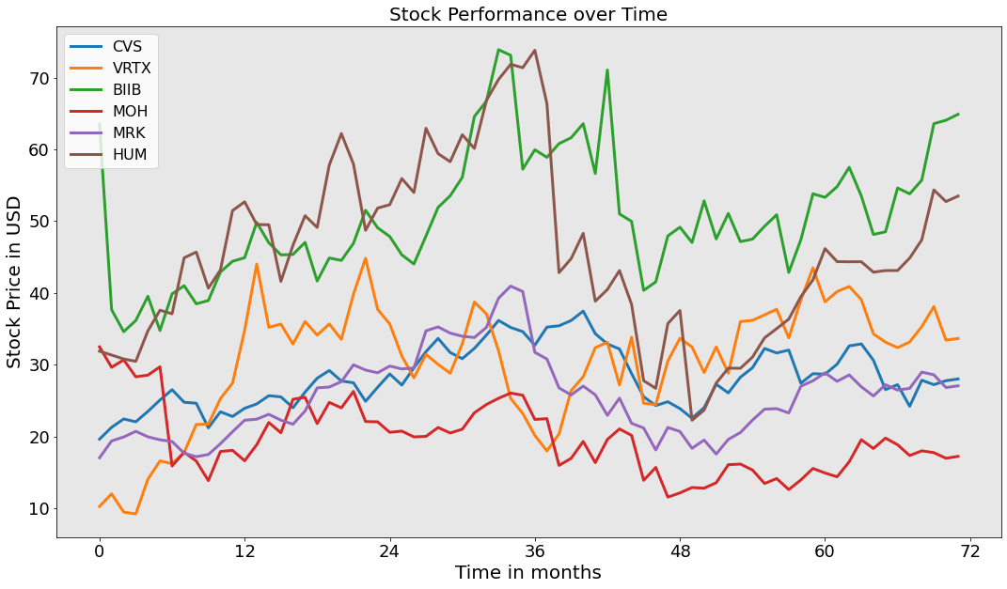
Health Stock Comparison 2005 - 2011
W
CVS(CVS Health Corp)
VRTX(Vertex Pharmaceuticals)
BIIB(Biogen)
MOH(Molina Healthcare)
MRK(Merck & Co)
HUM(Humana)
Notes:
Which Stock held its value over the years?
MRK
Which Stock had the greatest increase? Decrease?
Increase: VRTX Decrease: MOH

Slide 8
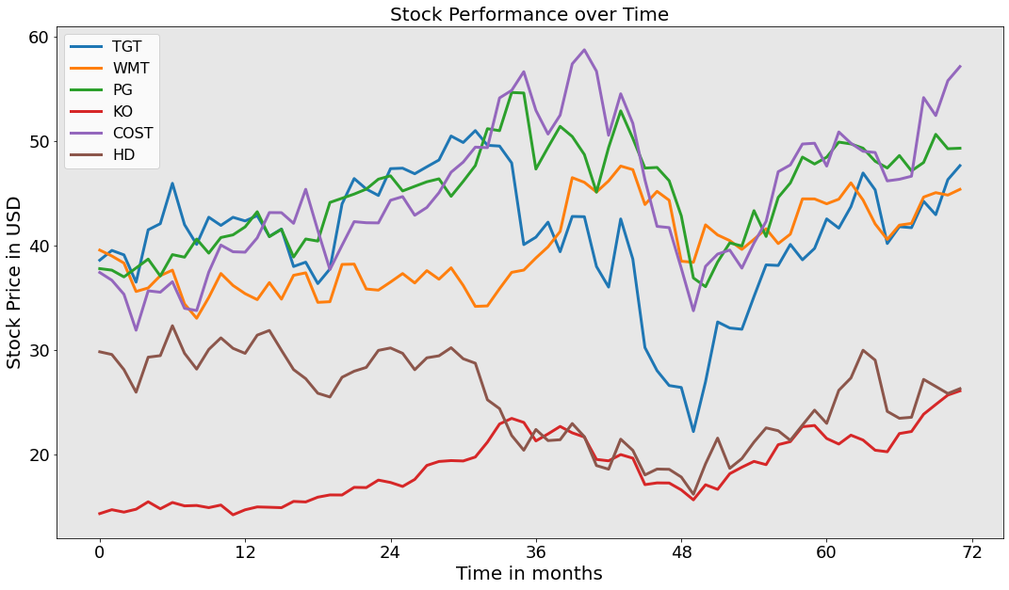
Consumer Staples Stock Comparison 2005 - 2011
W
TGT(Target)
WMT(Walmart)
PG(Procter & Gamble)
KO(Coca-Cola)
COST(Costco Wholesale)
HD(Home Depot)
Notes:
Which Stock held its value over the years?
Most consistent stock being Procter & Gamble or Walmart
Which Stock had the greatest increase? Decrease?
Increase: Coca Cola Decrease: Home Depot
Each company held together through the 5 year interval.

Slide 9
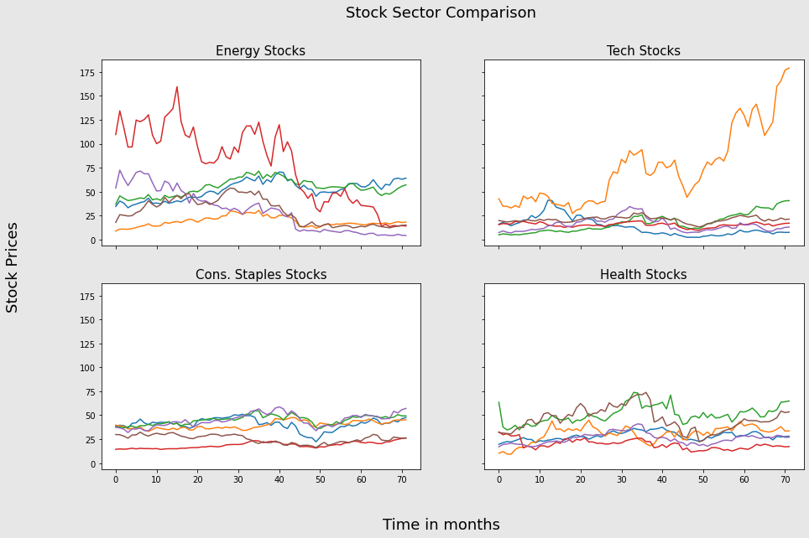
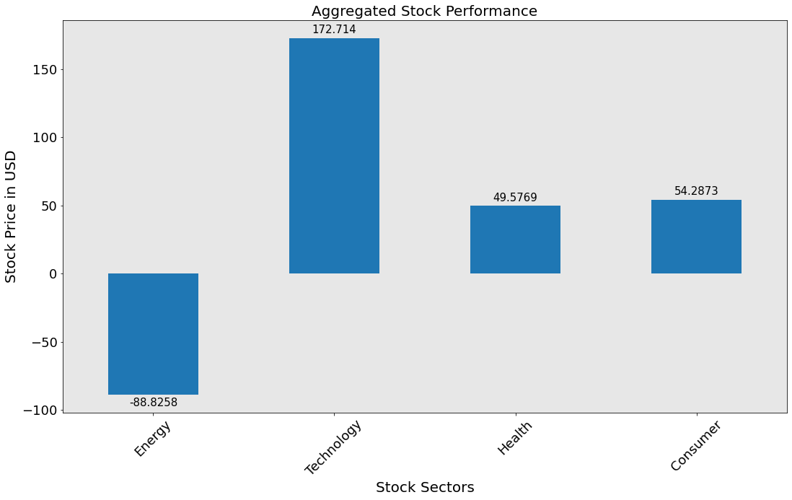
Stock Sector Comparison 2005 - 2011
B
Consumer Staples Consistency
Energy Company fall
Tech on the Rise
Notes:
Which Sector had biggest increase? Decrease?
Increase: Tech Companies Decrease: Energy Companies
Which field would we recommend to others?
Tech companies on the rise, Consumer staples for consistency.

Slide 10
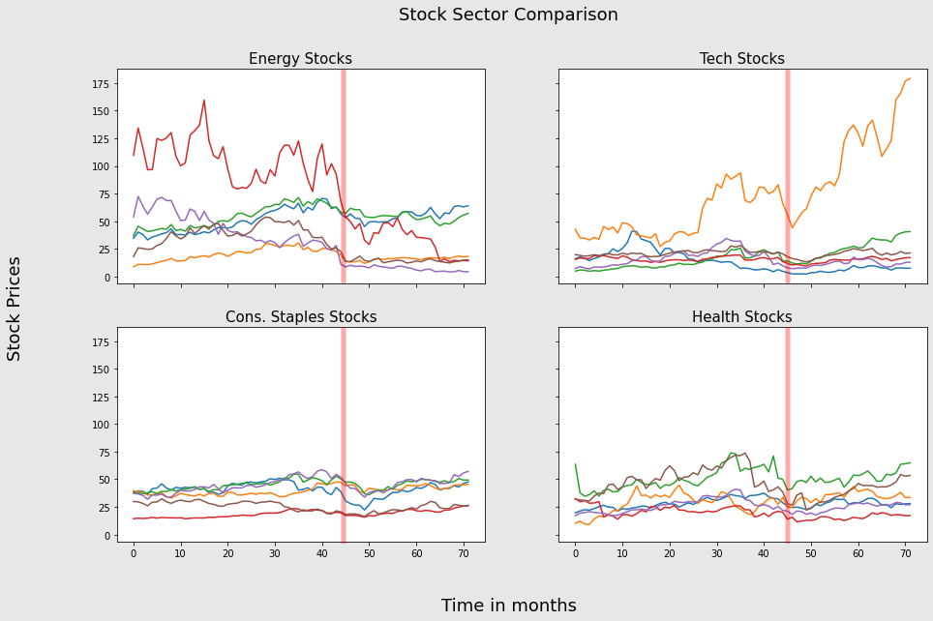
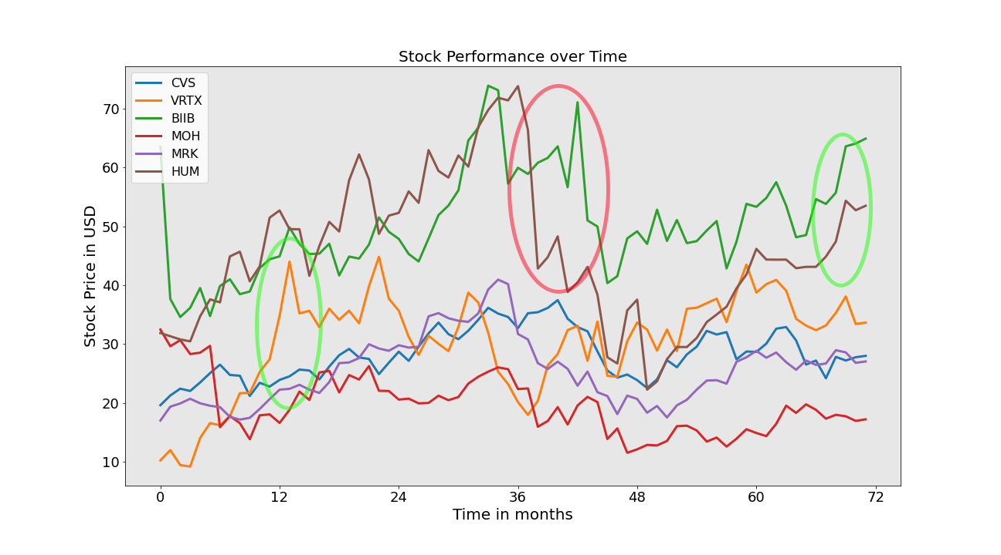
Stock Sector Patterns 2005 - 2011
B
Energy Sector - The only sector that lost adj. Value over time
Tech Sector - Fairly Consistent, with Amazon’s value significantly growing
Health Sector - Has the largest Variability over time. Huge Peaks and Valleys
Cons Staples. And Health Sector performed fairly similar, although Consumer is more reliable.
All Sectors - Significant Drop ~45 months in (about 2008/2009)
Health Sector
Notes:
Which Sector had biggest increase? Decrease?
Increase: Tech Companies Decrease: Energy Companies
Which field would we recommend to others?
Tech companies on the rise, Consumer staples for consistency.

Slide 11
Summary
B
Given the full duration, all sectors but Energy were profitable during this period.
FCEL (e), HD(c) , and MOH (h) were the only stocks that did not hold value or increase over time.
We would recommend the Tech Sector for growth, and the Consumer Staples Sector for consistency. For successful Day Traders, The Health Sector would be most profitable.
Amazon outperformed every other stock in our sample by a huge market.
FCEL showed the largest drop.
2008/2009 shows a dip across all stocks, from which most stocks recovered within 2 years.

